Slide 1
Presentation on Computer Software

Slide 2
Over view
_{About Computer}
_{Parts of computer}
_{Type of software}
_{Forms of Computer}
_{conclusion}

Slide 3
What is computer
COMPUTER stands for "A computer is a general purpose electronic device that is used to perform arithmetic and logical operations automatically.
C-Common
O-Operating
M-Machine
P-Purposely
U-Used for
T-Technological and
E-Educational
R-Research

Slide 4
PART OF computer
1 Hardware
2 SOFTWARE

Slide 5
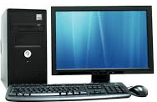
hardware
Hardware refers to the physical elements of a computer. Examples of hardware in a computer are keyboard, monitor, Mouse, cpu etc.

Slide 6
software
Software is a collection of programs
procedure, instruction that perform
some task on computer. Software Can be store in hardware.

Slide 7
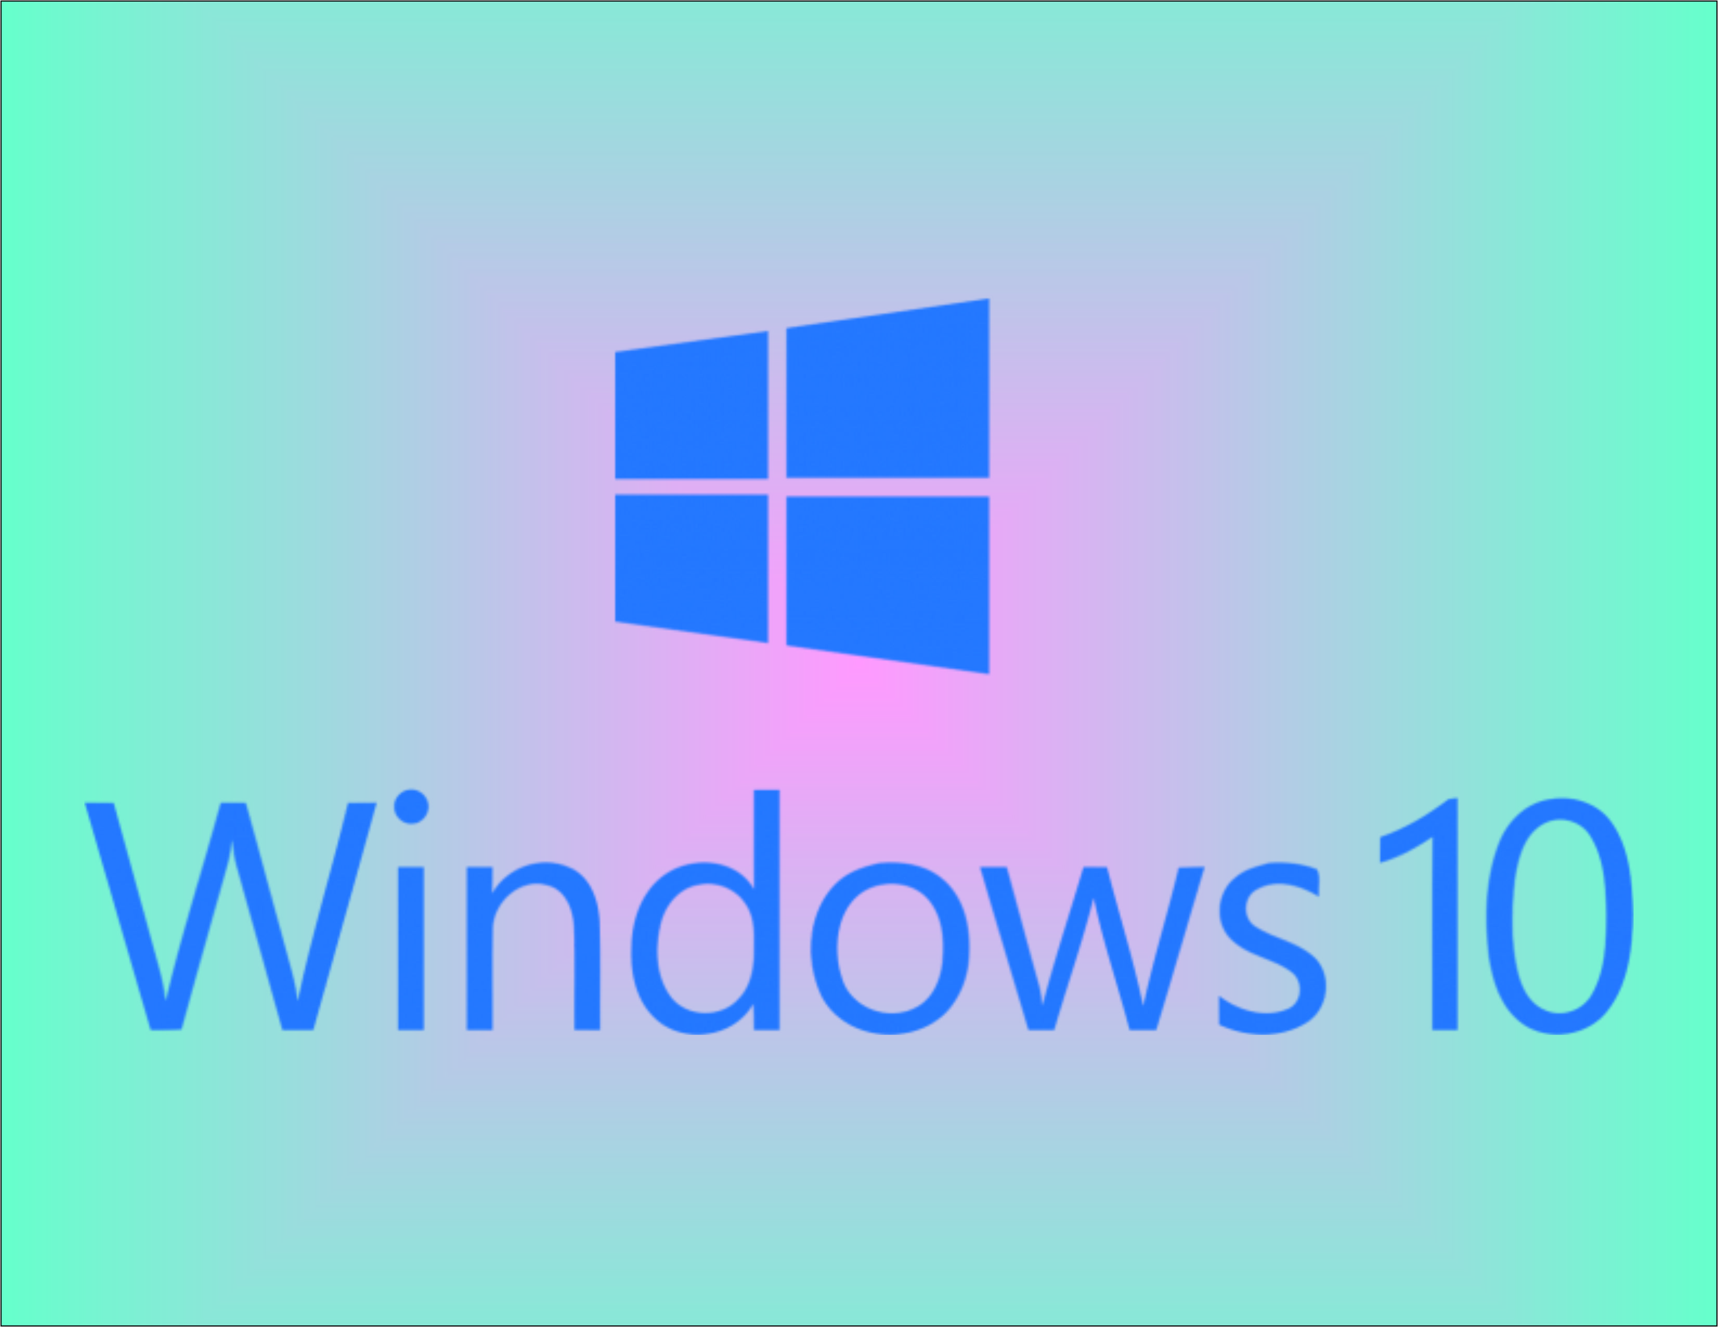
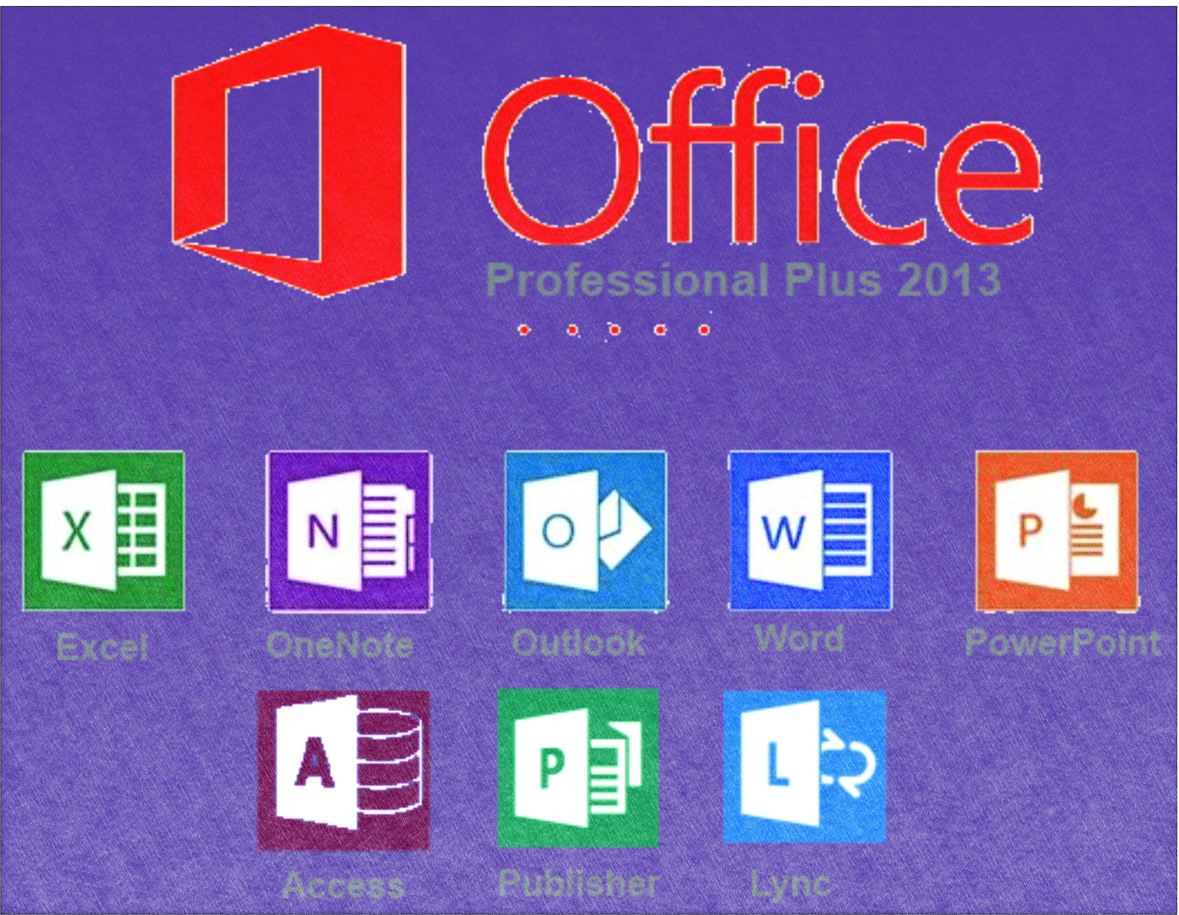

Slide 8
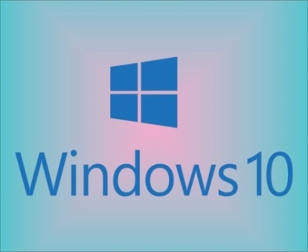
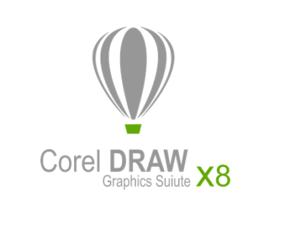

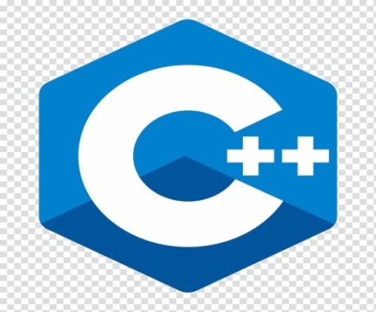
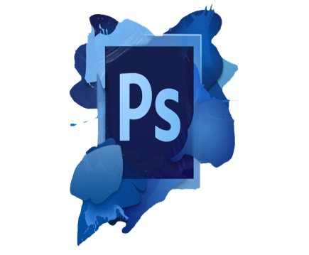
System
Application
Type of software
Utility
Programming
custom

Slide 9
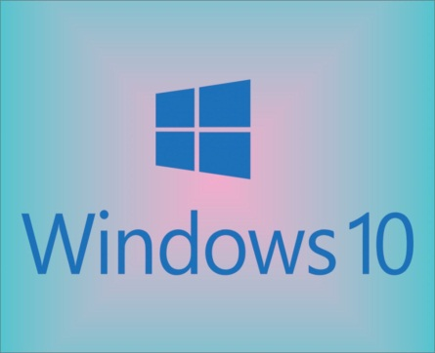
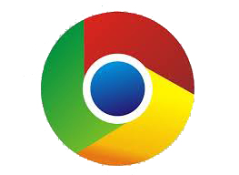



paid
free
Form of software
Open source
pirated
Shareware

Slide 10
CONCLUSION
DON’T
USE
Pirated software.

Slide 11
Only
Used
paid
and
open
source
software.

Slide 12
In CorelDraw

